Slide 1
Internet of Things (IoT) Programming
Kyle Johnsen

Slide 2
Basics of IoT
The field is defined by constraints:
Connectivity
Power
Security
Cost
Examples of IoT
Home Sensors/automation
Smart parking lots
Digital Twins
Much of the benefit comes from basic “telemetry”, but control is possible as well

Slide 3
IoT Messaging
Base layer is the Internet Protocol (IP), then Transport (TCP, UDP)
Routers “speak” IP to deliver packets between IP addresses
Devices “speak” TCP/UDP to deliver datagrams to specific services at IP addresses and Ports
Servers broker messages sent with protocols such as HTTP or MQTT
IOT relies upon connectable servers
Why can’t we connect directly? - Firewalls/Security/Random IP addresses
Note: The physical layer can be anything (Ethernet, WiFi, Bluetooth, LoRa, etc). As long as you get the ability to communicate over IP)

Slide 4
Options for IoT Servers
Private server (complex, but total flexibility)
Buy/own a public internet connection and connect a physical machine
Provision a computer in the cloud (free tiers exist) (AWS, Azure, Oracle)
Forward specific ports from your home router to a local computer
Public server (quick but constrained)
Ngrok - makes a tunnel through a public server to your local computer
PythonAnywhere - Run an application in the cloud
Cloudflare tunnels – Very flexible. Supports free (no sign-up) quick tunnels to locally running applications on your computer.

Slide 5
Messaging Options
MQTT - Message Queuing Telemetry Transport
A standard IoT communication framework (also useful for other things)
Publish-Subscribe model
Publish to a topic, Subscribe to a topic
Actual bytes sent are up to you
“Lightweight”
Options for security (nothing by default)
Relies upon publicly connectable brokers
Mosquitto is an open-source broker
HTTP - HyperText Transport Protocol
A standard Web communication Framework
Can be used for IOT
Often the only option because of security limitations
Request-Response model
Must create your own communication routes on the server

Slide 6
MQTT Basics
You first configure a client
Username/password (giiuser,giipassword)
Callback functions
Then you connect to a broker server
Need the ip address / host name & port -> eduoracle.ugavel.com, port 1883
After connecting (usually in the connection callback), you can subscribe and publish to topics
Topics are arbitrary strings (e.g., elee2045sp25/button/kjohnsen)
Slashes are used with wildcard #s to subscribe to many topics at a time
e.g., elee2045sp25/button/# would subscribe to any topic starting with elee2045sp25/button/
MQTT messages always contain the topic and a data payload
Payloads are arbitrary length byte arrays (e.g., a string, a struct, etc).
Messages published to a topic you have subscribed to are received in a callback function
You must check the topic to know how to read the message.

Slide 7
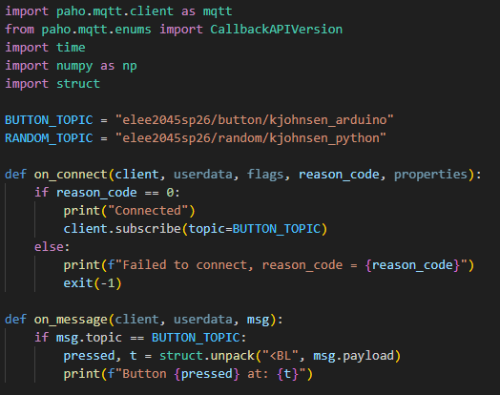
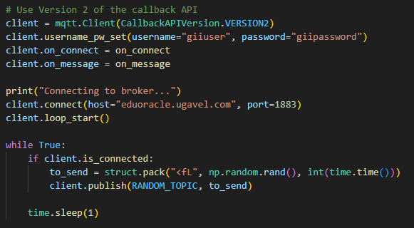
MQTT in Python (paho-mqtt)
pip install paho-mqtt
Subscribe after connecting, make sure you are connected when you publish

Slide 8
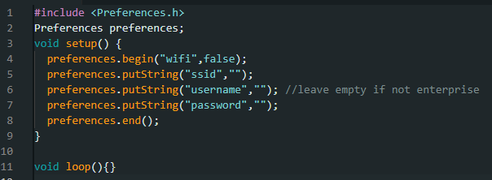
MQTT in Arduino (Part 1: WiFi Credentials)
You need to store your WiFi credentials inside the device by writing the below program (replacing the blank credentials with your own). Subsequent programs can read these credentials. This only needs to be done once, unless you change wifi networks. You could also store multiple, and just try them in succession.

Slide 9
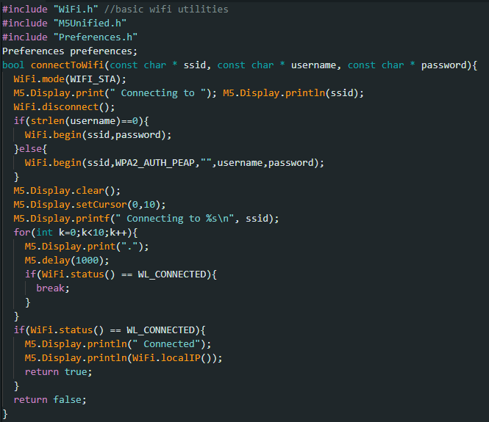
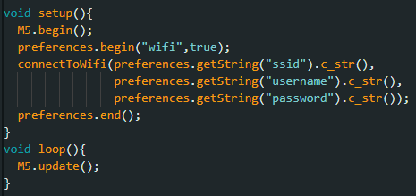
MQTT In Arduino (Part 2: WiFi Connection)
This is provided to you, but you are free to modify. You #include this in your program.
Call connectToWifi if not connected in your main program’s loop.
Note that if you do not supply a username, it will use WPA2 Personal
PAWS-Secure/Eduroam use WPA2_Enterprise.

Slide 10
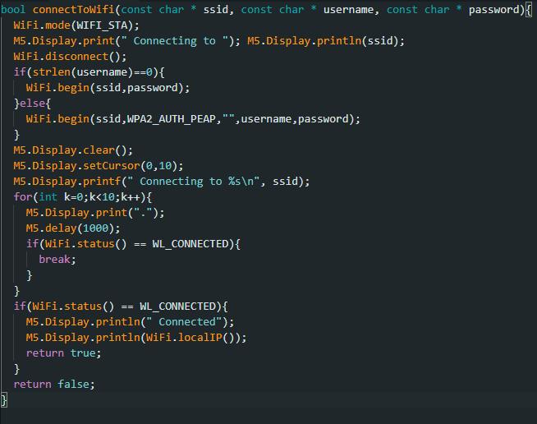
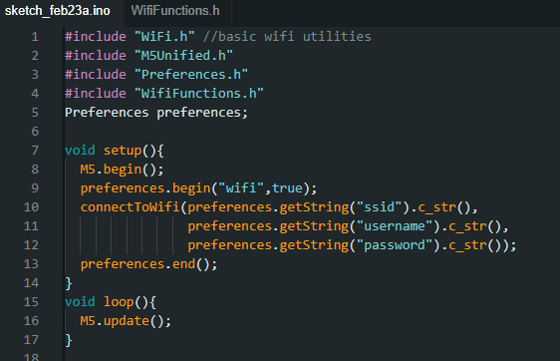
Breaking up your program to manage it

Slide 11
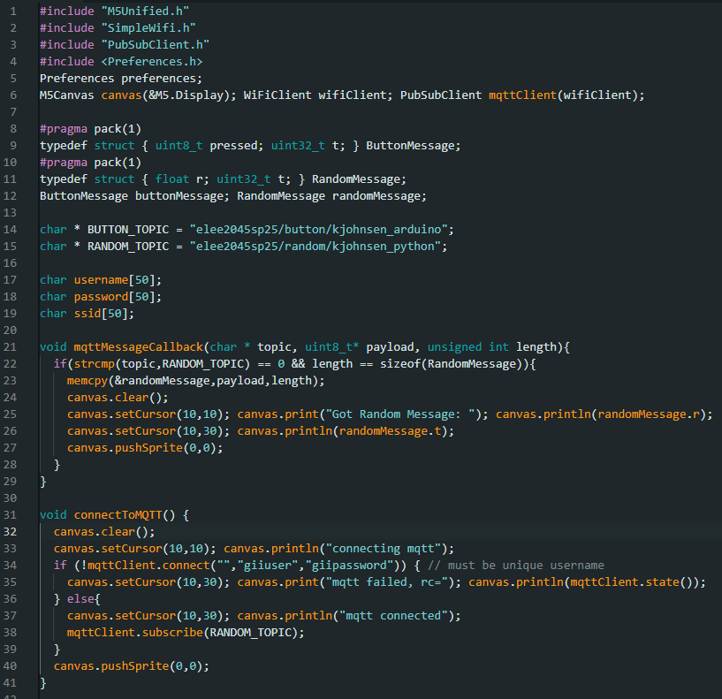
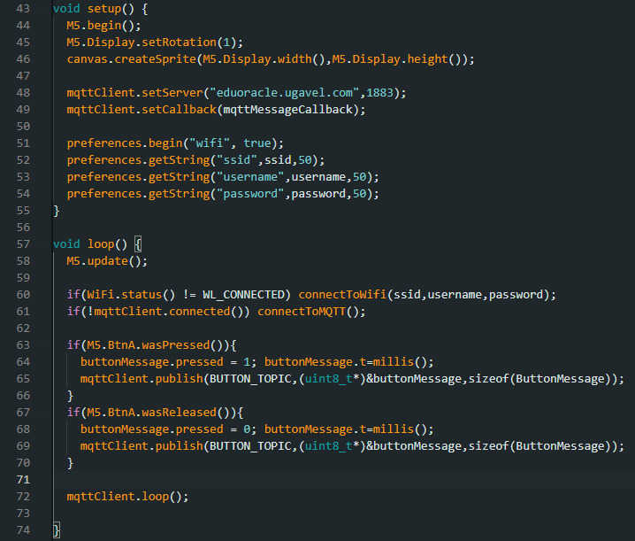
MQTT in Arduino (Part 3: pubsubclient)

